Slide 1
Optimizers

Slide 3
Outline
Challenges in Optimization
Momentum
Adaptive Learning Rate
Adam

Slide 4
Outline
Challenges in Optimization
Momentum
Adaptive Learning Rate
Adam

Slide 5
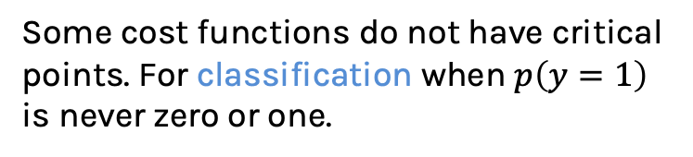
Challenges in Optimization
Local Minima
No critical points
Ideally, we would like to arrive at the global minimum, but this might not be possible. Some local minima performs as well as the global one, so it is an acceptable stopping point.
Some cost functions do not have critical points. For classification when $p\left(y=1\right)$ is never zero or one.

Slide 6
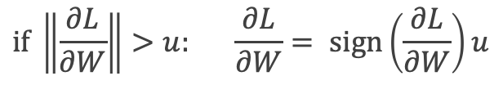
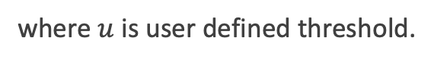
Challenges in Optimization
Exploding Gradients
Poor Conditioning
Exploding gradients due to cliffs. Can be mitigated using gradient clipping:
Poorly conditioned Hessian matrix. High curvature: small steps leads to huge increase. Learning is slow despite strong gradients. Oscillations slow down progress.
$$if \left\|\frac{∂L}{∂W}\right\|>u: \frac{∂L}{∂W}= sign\left(\frac{∂L}{∂W}\right)u$$
where $u$ is user defined threshold.

Slide 7
Challenges in Optimization: Vanishing Gradients

Slide 8
Outline
Challenges in Optimization
Momentum
Adaptive Learning Rate
Adam

Slide 9
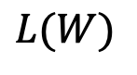
Momentum
Simple Gradient Descent oscillates because updates do not exploit curvature information
$$L(W)$$
$$W_{2}$$
$$W_{1}$$
Notes:
https://distill.pub/2017/momentum/

Slide 10
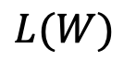
Momentum
Let us figure out an algorithm which will converge to the minimum faster. We first examine the partial derivatives of the loss
$$L(W)$$
$$W_{2}$$
$$W_{1}$$
Notes:
https://distill.pub/2017/momentum/

Slide 11
Momentum
Look each component at a time. And see the average behavior of each component
$$L(W)$$
$$W_{2}$$
$$W_{1}$$
Notes:
https://distill.pub/2017/momentum/

Slide 12
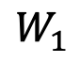
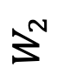
Momentum
Let us figure out an algorithm which will converge to the minimum faster.
Average gradient presents faster path to optimal: vertical components cancel out!
$$L(W)$$
$$W_{2}$$
$$W_{1}$$
Notes:
https://distill.pub/2017/momentum/

Slide 13
Momentum
Let us figure out an algorithm
$$L(W)$$
The average of the vertical direction is small!
$$W_{2}$$
$$W_{1}$$
Notes:
https://distill.pub/2017/momentum/

Slide 14
Momentum
Let us figure out an algorithm
$$L(W)$$
$$W_{2}$$
$$W_{1}$$
Notes:
https://distill.pub/2017/momentum/

Slide 15
Momentum
Let us figure out an algorithm
$$L(W)$$
The average of the horizontal direction is large!
$$W_{2}$$
$$W_{1}$$
Notes:
https://distill.pub/2017/momentum/

Slide 16
Momentum
Add current gradient and previous trend
Add the average of the gradient from before
$$L(W)$$
New current gradient
Current gradient
$$W_{2}$$
New trend up to this moment
Average “trend” gradient up to this moment
$$W_{1}$$
Notes:
Show that momentum is from past

Slide 17
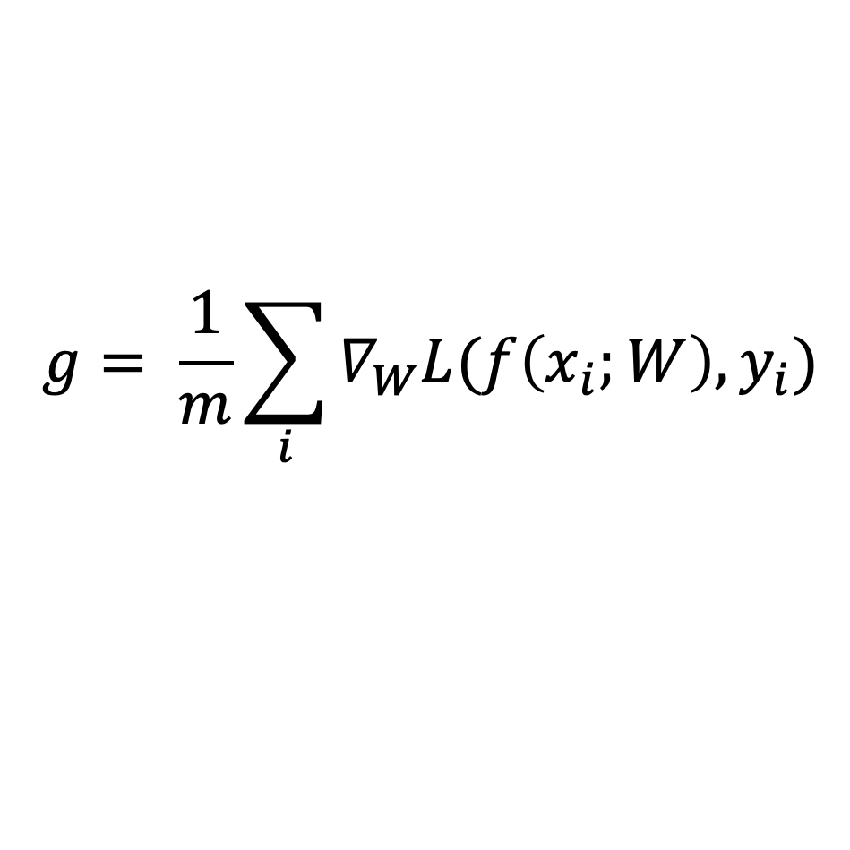
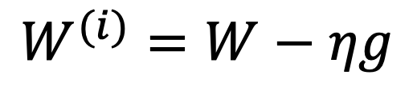

Momentum
$f$is the Neural Network
Old gradient descent:
$$g= \frac{1}{m}\sum_{i}{∇_{W}L(f\left(x_{i};W\right),y_{i})}$$
$$W^{(i)}=W−ηg$$

Slide 18
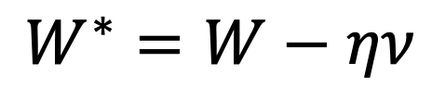
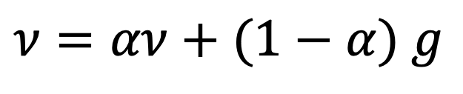
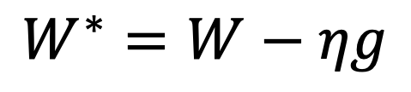
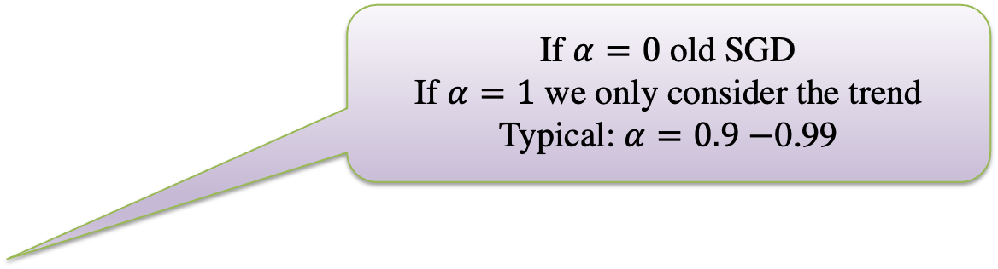

Momentum
$f$is the Neural Network
Old gradient descent:
New gradient descent with momentum:
$$g= \frac{1}{m}\sum_{i}{∇_{W}L(f\left(x_{i};W\right),y_{i})}$$
$$W^{∗}=W−ηg$$
If $α=0$ old SGD
If $α=1$ we only consider the trend
Typical: $α=0.9−$0.99
$$ν=αν+(1−α) g$$
$$W^{∗}=W−ην$$
controls how quickly effect of past gradients decay
Notes:
Introduce normal momentum and then Nesterov

Slide 19
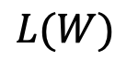
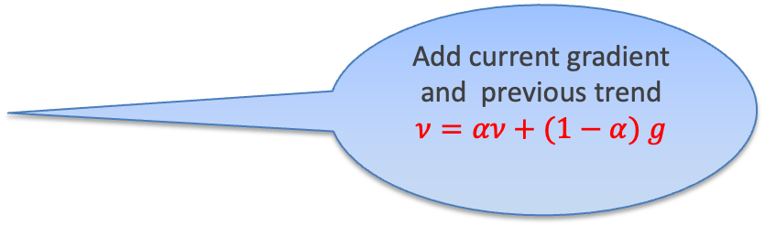
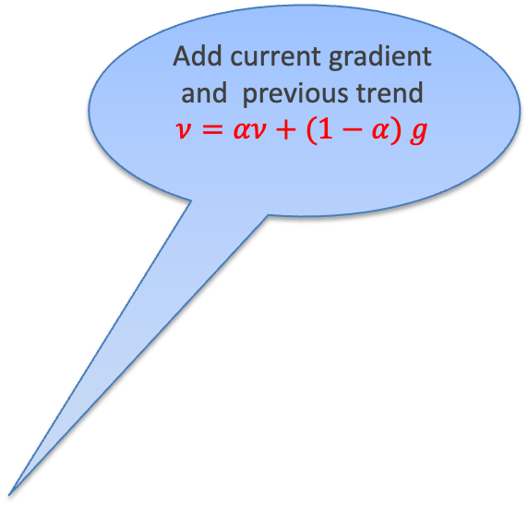
Momentum
Add current gradient and previous trend
$$ν=αν+(1−α) g$$
Add the average of the gradient from before
$$L(W)$$
New current gradient, g
Current gradient, g
$$W_{2}$$
Add current gradient and previous trend
$$ν=αν+(1−α) g$$
New trend up to this moment, v
Average “trend” up to this moment, v
$$W_{1}$$
Notes:
Show that momentum is from past

Slide 20
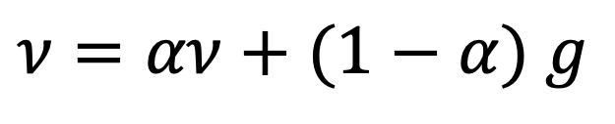
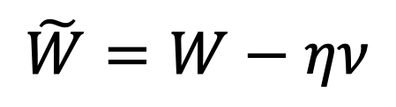
Nesterov Momentum
It is a slightly different version of the momentum update that has recently been gaining popularity. And it has better theoretical converge guarantees converges (at least for convex functions).
The idea is to look ahead of the weights and apply an interim update:
New gradient descent with Nesterov momentum:
$$ν=αν+(1−α) g$$
$$\tilde{W}=W−ην$$
Notes:
Introduce normal momentum and then Nesterov

Slide 21
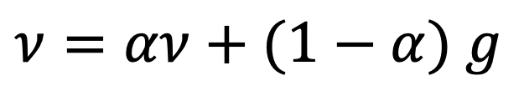
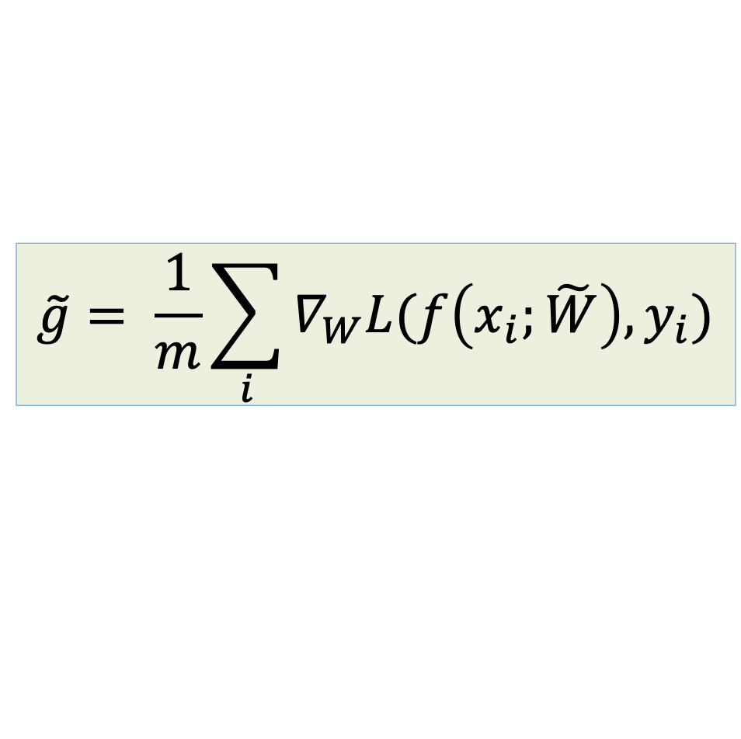

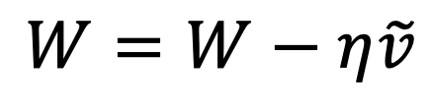
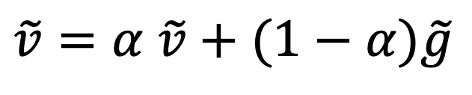
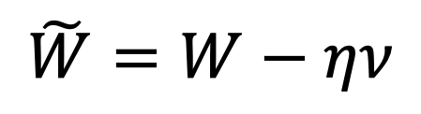
Nesterov Momentum
$$ν=αν+(1−α) g$$
$$\tilde{W}=W−ην$$
Re-calculate the gradient, $\tilde{g,}$ with the new weight, $\tilde{W}$
$$\tilde{g}= \frac{1}{m}\sum_{i}{∇_{W}L(f\left(x_{i};\tilde{W}\right),y_{i})}$$
Find a new momentum, $\tilde{v},$with the new intermediate gradient, $\tilde{g}$. And update using gradient descent.
$$\tilde{v}=α \tilde{v}+(1−α)\tilde{g}$$
$$W=W−η\tilde{v}$$
Notes:
Introduce normal momentum and then Nesterov

Slide 22
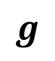



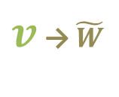
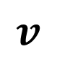

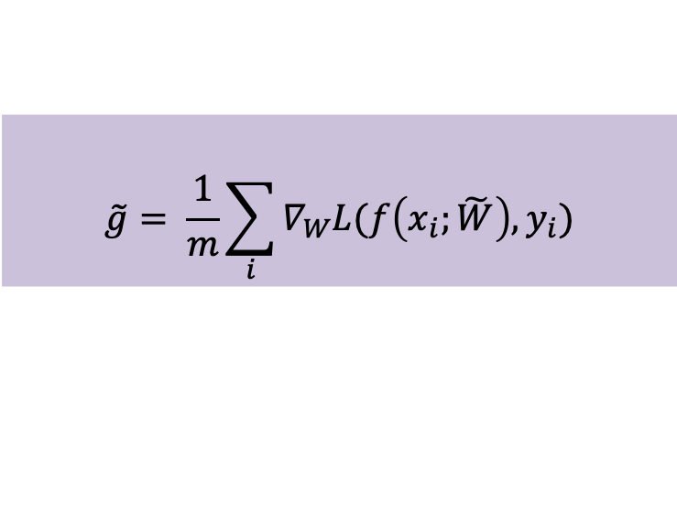
Nesterov Momentum visually
$$g$$
$$ν=αν+(1−α) g$$
$$\tilde{g}$$
$$\tilde{W}=W−ην$$
$$\tilde{g}= \frac{1}{m}\sum_{i}{∇_{W}L(f\left(x_{i};\tilde{W}\right),y_{i})}$$
$v$ → $\tilde{W}$
$$\tilde{W}$$
$$w$$
$$v$$

Slide 23

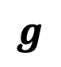



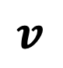

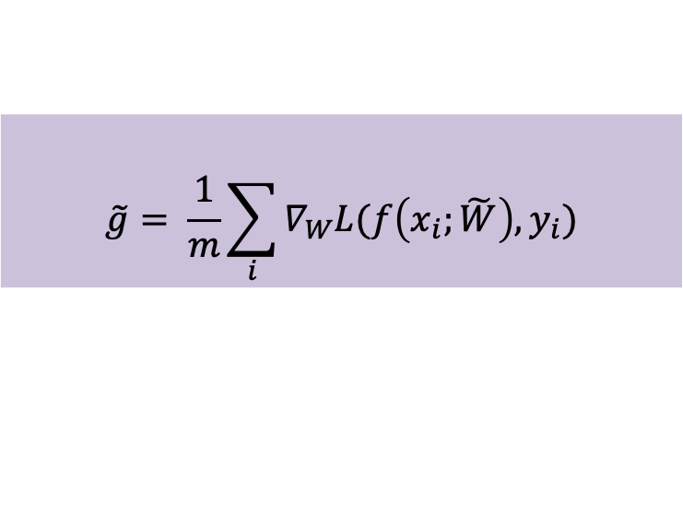
Nesterov Momentum visually
$$g$$
$$ν=αν+(1−α) g$$
$$\tilde{g}$$
$$\tilde{W}=W−ην$$
$$\tilde{g}= \frac{1}{m}\sum_{i}{∇_{W}L(f\left(x_{i};\tilde{W}\right),y_{i})}$$
$\tilde{v}$
$$W$$
$$w$$
$$\tilde{v}=α \tilde{v}+(1−α)\tilde{g}$$
$$v$$
$$W=W−η\tilde{v}$$

Slide 24





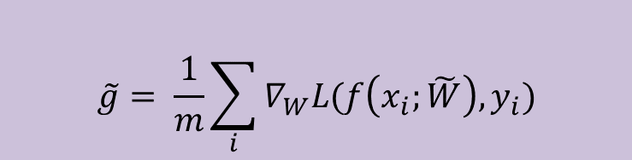
(contd.)
$$g$$
$$ν=αν+(1−α) g$$
$$\tilde{g}$$
$$\tilde{W}=W−ην$$
$$\tilde{g}= \frac{1}{m}\sum_{i}{∇_{W}L(f\left(x_{i};\tilde{W}\right),y_{i})}$$
$v$ → $\tilde{W}$
$$\tilde{W}$$
$$\tilde{W}$$
$$w$$
$$\tilde{v}=α \tilde{v}+(1−α)\tilde{g}$$
$$v$$
$$W=W−η\tilde{v}$$

Slide 25
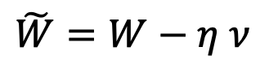
Nesterov Momentum
Apply an interim update:
Perform a correction based on gradient at the interim point:
$$\tilde{W}=W−η ν$$
$$g= \frac{1}{m}\sum_{i}{∇_{W}L(f\left(x_{i};\tilde{W}\right), y_{i})}$$
Momentum based on look-ahead slope

Slide 26
Outline
Challenges in Optimization
Momentum
Adaptive Learning Rate
Adam

Slide 27
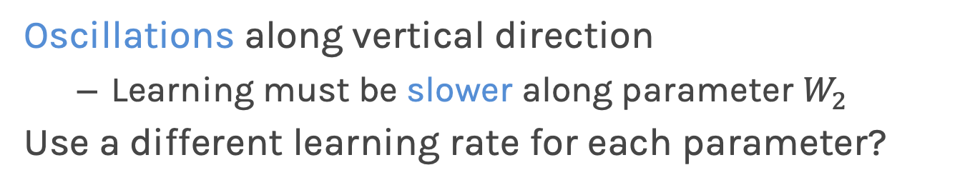
Adaptive Learning Rates
$$L(W)$$
$$W_{2}$$
Slow
Fast
$$W_{1}$$
Oscillations along vertical direction
Learning must be slower along parameter $W_{2}$
Use a different learning rate for each parameter?

Slide 28
Adaptive Learning Rates
$$L(W)$$
$$W_{2}$$
Slow
Fast
$$W_{1}$$
Oscillations along vertical direction
Learning must be slower along parameter $W_{2}$
Use a different learning rate for each parameter?

Slide 29
Adaptive Learning Rates
$$L(W)$$
$$W_{2}$$
Slow
Fast
$$W_{1}$$
Oscillations along vertical direction
Learning must be slower along parameter $W_{2}$
Use a different learning rate for each parameter?

Slide 30
Adaptive Learning Rates
$$L(W)$$
$$W_{2}$$
Slow
Fast
$$W_{1}$$
Oscillations along vertical direction
Learning must be slower along parameter $W_{2}$
Use a different learning rate for each parameter?

Slide 31
Adaptive Learning Rates
$$L(W)$$
$$W_{2}$$
Slow
Fast
$$W_{1}$$
With different learning rates we can control the oscillations.

Slide 32
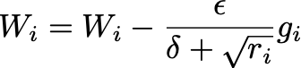
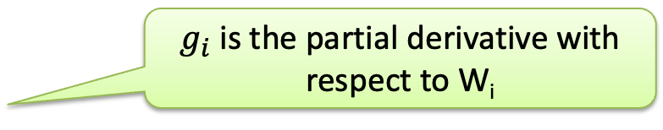
AdaGrad
Accumulate squared gradients:
Update each parameter:
Greater progress along gently sloped directions
$g_{i}$is the partial derivative with respect to W_{i}
Inversely proportional to cumulative gradient

Slide 33
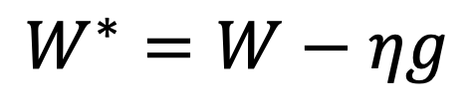
AdaGrad
Old gradient descent:
$$g= \frac{1}{m}\sum_{i}{∇_{W}L(f\left(x_{i};W\right),y_{i})}$$
$$W^{∗}=W−ηg$$

Slide 34
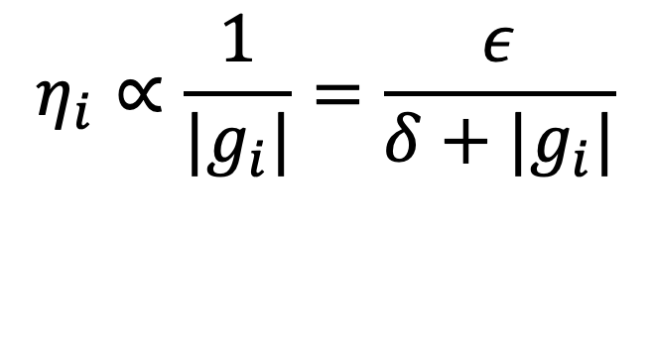
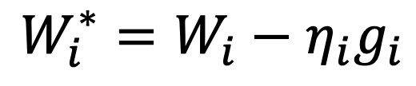
AdaGrad
Old gradient descent:
$$g= \frac{1}{m}\sum_{i}{∇_{W}L(f\left(x_{i};W\right),y_{i})}$$
$$W^{∗}=W−ηg$$
We would like $η^{′}s$ not to be the same and be inversely proportional to the${|g}_{i}|$
$$W_{i}^{∗}=W_{i}−η_{i}g_{i}$$
$$η_{i}∝\frac{1}{{|g}_{i}|}=\frac{ε}{δ+|g_{i}|}$$

Slide 35
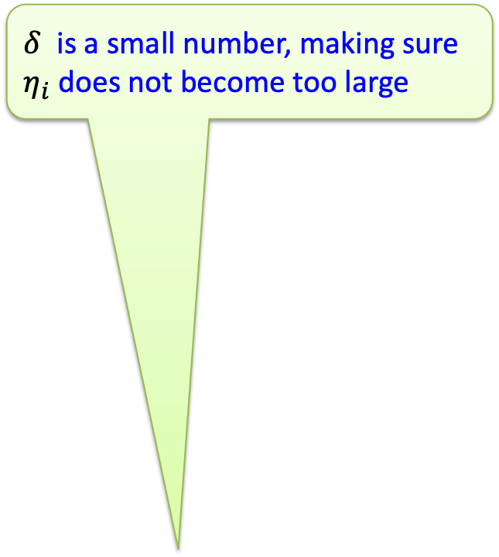
AdaGrad
$δ$ is a small number, making sure $η_{i}$ does not become too large
Old gradient descent:
$$g= \frac{1}{m}\sum_{i}{∇_{W}L(f\left(x_{i};W\right),y_{i})}$$
$$W^{∗}=W−ηg$$
We would like $η^{′}s$ not to be the same and be inversely proportional to the${|g}_{i}|$
$$W_{i}^{∗}=W_{i}−η_{i}g_{i}$$
$$η_{i}∝\frac{1}{{|g}_{i}|}=\frac{ε}{δ+|g_{i}|}$$

Slide 36
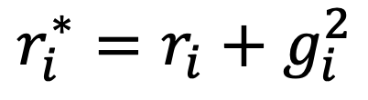
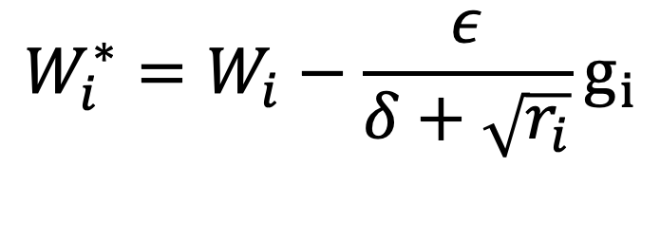
AdaGrad
$δ$ is a small number, making sure $η_{i}$ does not become too large
Old gradient descent:
$$g= \frac{1}{m}\sum_{i}{∇_{W}L(f\left(x_{i};W\right),y_{i})}$$
$$W^{∗}=W−ηg$$
We would like $η^{′}s$ not to be the same and be inversely proportional to the${|g}_{i}|$
$$W_{i}^{∗}=W_{i}−η_{i}g_{i}$$
$$η_{i}∝\frac{1}{{|g}_{i}|}=\frac{ε}{δ+|g_{i}|}$$
New gradient descent with adaptive learning rate:
$$W_{i}^{∗}=W_{i}−\frac{ε}{δ+\sqrt{r_{i}}}g_{i}$$
$$r_{i}^{∗}=r_{i}+g_{i}^{2}$$
Notes:
Remove dashed lines

Slide 37
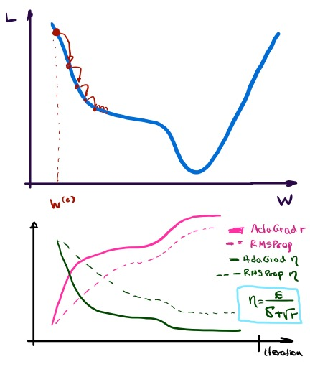
RMSProp
For non-convex problems, AdaGrad can prematurely decrease learning rate
Use exponentially weighted average for gradient accumulation

Slide 38
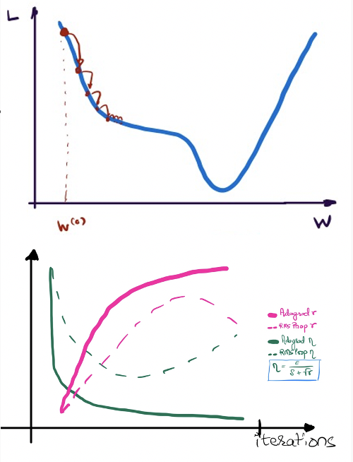
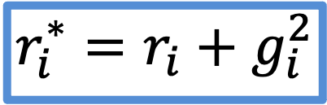
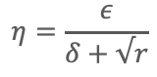
RMSProp
For non-convex problems, AdaGrad can prematurely decrease learning rate
Use exponentially weighted average for gradient accumulation
AdaGrad
RMSProp
$$r_{i}^{∗}=r_{i}+g_{i}^{2}$$
$$η=\frac{ε}{δ+√r}$$
Notes:
Somehow connect diagram with equations.

Slide 39
Outline
Challenges in Optimization
Momentum
Adaptive Learning Rate
Adam

Slide 40
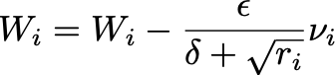
Adam: RMSProp + Momentum
Estimate first moment:
Estimate second moment:
Update parameters:
Also applies bias correction to v and r
Works well in practice, it is robust to hyper-parameters

Slide 41



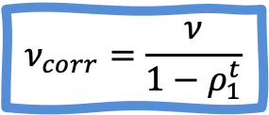
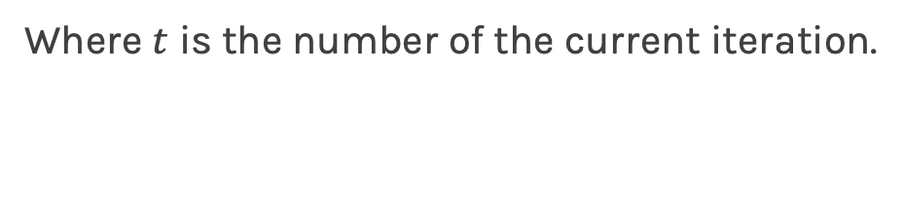
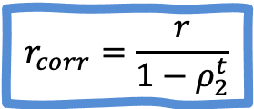
Bias Correction
To perform bias correction on the two running average variables, we use the following equations. We do this before we update weights.
$$ν_{corr}=\frac{ν}{1−ρ_{1}^{t}}$$
$$r_{corr}=\frac{r}{1−ρ_{2}^{t}}$$
Where $t$ is the number of the current iteration.
1st and 2nd moment gradient estimates are started off with both estimates being zero. Hence those initial values for which the true value is not zero, would bias the results.

Slide 42


CS109B GAME Time

Slide 43
Which all among the following can help deal with the problem of exploding gradients?
Options
Gradient Clipping
Weight Regularization
Adam
Reduce network depth

Slide 44
Which all among the following can help deal with the problem of exploding gradients?
Options
Gradient Clipping
Weight Regularization
Adam
Reduce network depth

Slide 45
After running model.fit(...) on your neural network, which code will print your training loss?
Options
A. plt.plot(model.history['loss’])
B. plt.plot(model.history.history['train_loss’]
C. plt.plot(model['train_loss’])
D. plt.plot(model.history.history['loss’])
E. plt.plot(model.history['loss'])

Slide 46
After running model.fit(...) on your neural network, which code will print your training loss?
Options
A. plt.plot(model.history['loss’])
B. plt.plot(model.history.history['train_loss’]
C. plt.plot(model['train_loss’])
D. plt.plot(model.history.history['loss’])
E. plt.plot(model.history['loss'])

Slide 47
Why is bias correction required for Adam?
Options
A. To ensure faster convergence.
B. To reduce the oscillations in case of complex loss functions.
C. To account for the initialization for the moments at the origin.
D. To ensure a higher initial momentum.

Slide 48
Why is bias correction required for Adam?
Options
A. To ensure faster convergence.
B. To reduce the oscillations in case of complex loss functions.
C. To account for the initialization for the moments at the origin.
D. To ensure a higher initial momentum.

Slide 49
In [5]: names_list = [‘mark','pavlos’,’chris']
In [6]: age_list = [59,25,20]
Out[7]: {‘mark’: 59, 'pavlos': 25, ‘chris': 20}
Options
{name:age for name,age in (names_list,age_list)}
{name:age for name,age in names_list,age_list}
{name:age for name,age in zip(names_list,age_list)}
{name:age for name,age in zip(*(names_list,age_list))}

Slide 50
In [5]: names_list = [‘mark','pavlos’,’chris']
In [6]: age_list = [60,25,20]
Out[7]: {'mark': 29, 'pavlos': 25, 'chris': 20}
Options
{name:age for name,age in (names_list,age_list)}
{name:age for name,age in names_list,age_list}
{name:age for name,age in zip(names_list,age_list)}
{name:age for name,age in zip(*(names_list,age_list))}

Slide 51
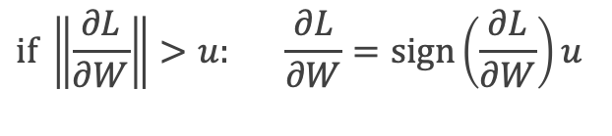
Exercise: Clipping
The aim of this exercise is to understand gradient clipping and learning rate decay.
Implement a function to clip exploding gradients
Experiment with different learning rates, clipping threshold
$$if \left\|\frac{∂L}{∂W}\right\|>u: \frac{∂L}{∂W}=sign\left(\frac{∂L}{∂W}\right)u$$

Slide 52

Exercise: RMS Prop vs Learning rate decay
The aim of this exercise is to visualize various learning rate scheduling strategies
Make a choice for the learning rate, decay rate and starting point for the weight
Based on the choices, visualize the loss landscape to see how quickly each strategy converges to the local minima
Change the parameters to see if the updates are consistent with the equations for the various strategies

Slide 53

Exercise: Momentum
The aim of this exercise is to understand gradient descent with momentum algorithm.
Implement a function incorporate momentum in gradient descent
Perform modified gradient Descent with momentum on the synthetic data
Experiment with different values of momentum parameter and learning rates to observe convergence with help of the helper plot

Slide 54

Exercise: Adam Optimizer
The aim of this exercise is to understand gradient descent with Adam optimizer
Write a function to implement gradient descent with Adam
Make sure to account for bias correction for 1st and 2nd moment gradient
Use the helper function to visualize how the descent works and compare the speed of convergence with vanilla gradient descent

